Slide 1

Assignment 5- CO2 Emissions

Slide 2

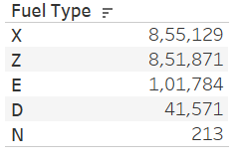
EXECUTIVE SUMMARY
The 5 Fuel Types that are currently being used in the market
X = regular gasoline
Z = premium gasoline
D = diesel
E = ethanol (E85)
N = natural gas
Selected a mix of 10 High End and Low end Brand to check the emissions and fuel type. Majority of them use X & Z fuel types
RECOMMENDATION
Manufacture more diesel and natural gas based in the market
Diesel gives your car longer life and saves you money in the long-run and also its better for the environment
Create more awareness and enforce the severity of the situation to Automobile Manufactures
CHALLENGES
Getting Government to enforce rules and making the changes required mandatory
Convincing the Automobile manufactures to create more environment friendly engines
Creating awareness among public to find alternative transportation solution
Reduce the Carbon Emissions from categories X & Z and move into more environment friendly models
Reduce usage of X & Z by about 10%
Encourage Ethanol and Natural gas usage by 10 % to start off with

Slide 3










SAMPLE SET

Slide 4
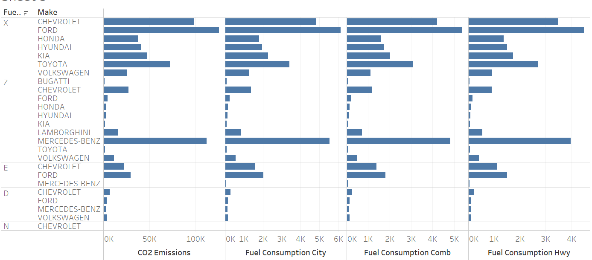
FUEL TYPE BASED COMPARISON
The chart above shows the car manufactures having different fuel type engines and the corresponding comparison between CO2 emission ,fuel consumption etc.
In Fuel type X Ford has maximum emission as compared to the other makes in the same category.
Except Chevrolet no other manufacturing are producing engines for natural gas

Slide 5
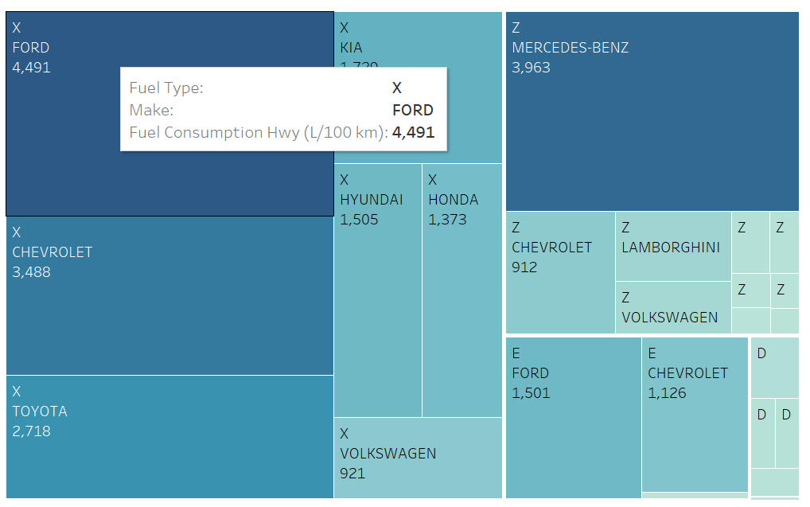
FUEL CONSUMPTION
In terms of fuel consumption the observation is as follows:
X fuel is widely consumed as compared to the others
There is almost no existence of natural gas consumption in any of the brands selected
Ford and Chevrolet as brands seem to be manufacturing mixed model cars

Slide 6
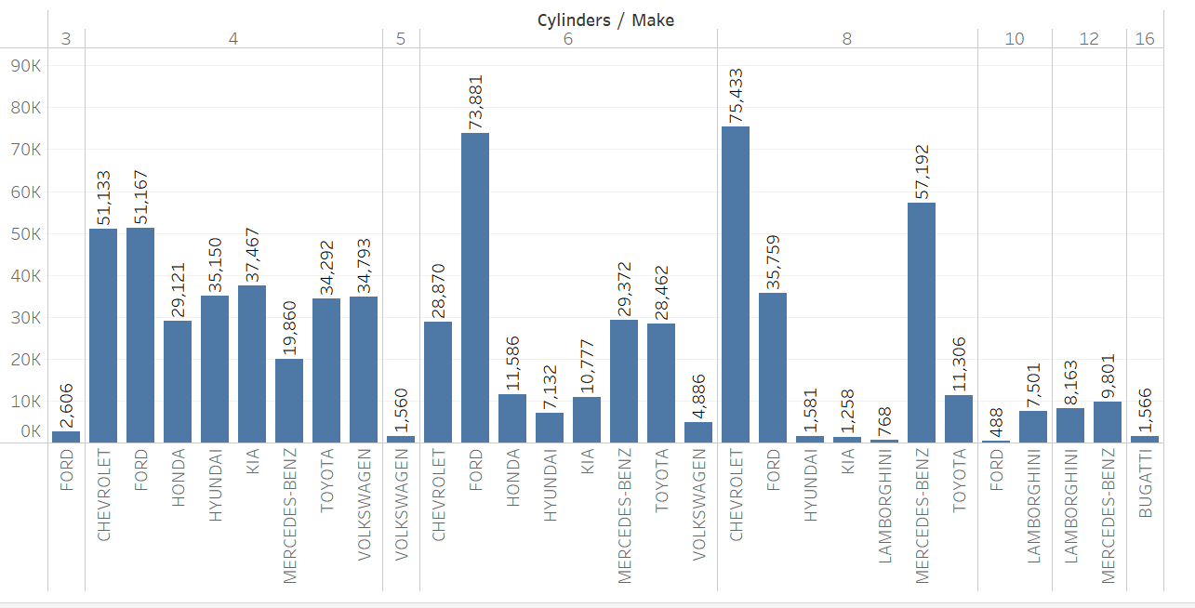
COMPARISON WITH THE CYLINDERS AND MAKE
Higher the number of cylinders more will the fuel consumption and CO2 emission. In the chart above the Higher end models Bugatti has an emission of 522 alone, followed by Benz and Lamborghini. The chart doesn’t really depict this as the data size if limited for higher end models

Slide 7
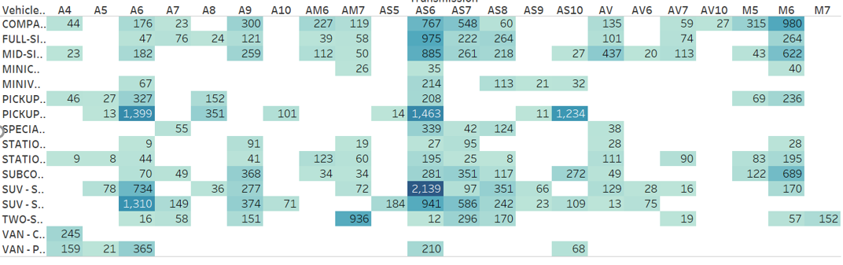
FUEL CONSUMPTION WITH VEHICLE TYPE & TRANSMISSION
In terms of fuel consumption the observation is as follows:
X fuel is widely consumed as compared to the others
There is almost no existence of natural gas consumption in any of the brands selected
Ford and Chevrolet as brands seem to be manufacturing mixed model cars

Slide 8
CONCLUSION
Reduce the CO2 emissions which are harmful to the environment
Move to more sustainable fuel type which will help reduce the pollution
Study was conducted on a sample dataset. Take the complete dataset and analyse if there are any change in the finding or it remains the same.
Appeal to the general public , car manufactures and Government to take the necessary steps to ensure we have a better tomorrow.
Luxury cars with higher cylinder are contributing to higher CO2 emissions.

Slide 9


